Slide 1
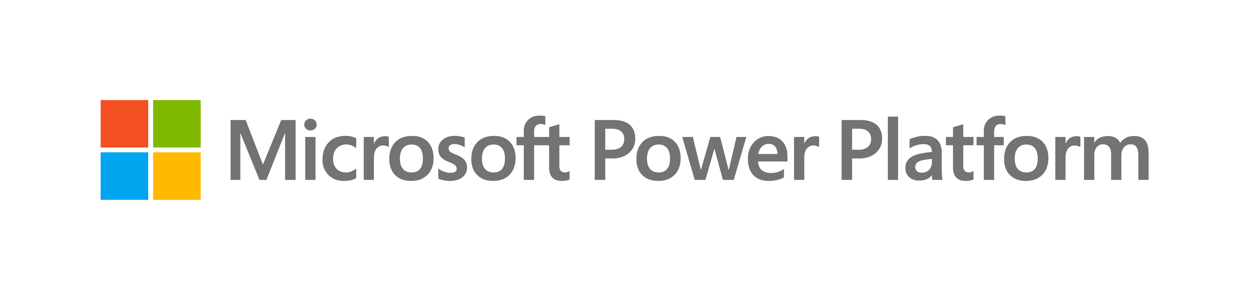
The power of the platform
Notes:
Good morning, everyone and thank you for joining me today!
Let’s talk about Power of the Platform and how the Power Platform is the best toolset to create enterprise solutions with AI, on your terms.

Slide 2

Empower everyone who needs to create business software.
Notes:
Microsoft’s mission is “Empower every person and organization in the planet to achieve more”.
Our mission in Power Platform is to empower everyone who needs to create business software by giving them the best toolset in the planet.
In other words, if you have a business problem that can be solved with software, we want to provide you the best tools in the world to solve it, no matter what the problem is.
Now, empower means something very specific in the Power Platform: Our rich tools, which are many, best in class in the industry, and we are very proud of, take the backseat..…and your business needs, context and constraints take the front seat.
The tools are at the service of your needs and can accommodate any context and constraints, so you can use them in your terms. Your business goals come first, and our products are just tools to help you achieve those goals efficiently!

Slide 3
No
Code
Low
Code
External
Your solutions,
your way
Vibe
Code
Internal
Now, augmented.
Pro
Code
Copilot
Spec-driven
Notes:
When it comes to how, there are many ways to build a applications: you can go no-code, low code, vibe-code, pro-code, or whatever is the next market trend that will come up in the next few months. We will have it! For example, these days spec-driven development is very popular and we support it. In all cases, we will always support all ways to build your enterprise grade apps with high quality. And, very importantly, you don’t have to pick only one way: you can chose and move between these based on the needs and context of your project.
When it comes to what, you can build web apps, desktop apps, mobile apps, kiosks, web sites. As the market evolve, we evolve with it to. For example, we support composable and decomposable apps that can be part of an agent conversation. And also, you don’t have to pick only one path: again, you can move freely based on the needs of your project.
Finally, when it comes to Where to deploy, you can deploy insider or outside your firewall and now into Copilot too.
And, as the market keeps evolving, the how, what and where evolves with it, so you can always get the best toolset to build enterprise solutions.
We fundamentally believe that these are your solutions, so you can create them your own ways, based on your needs and constraints.
And now, all of this is augmented with Al and agents!

Slide 4

Managed
security
Advanced
protection for an
AI-driven world
Managed
governance
More visibility, more control, less effort
Managed operations
Operational
excellence for
agents at scale
Managed availability
Enterprise-grade reliability for mission critical workloads
All deployed on an enterprise ready platform.
Notes:
Although we talk about choice, when working with Power Platform there is always one constant: all solutions are deployed in an enterprise ready platform that includes managed security, managed governance, managed operations, and managed availability.
So, no matter how you build, what do you build, or where you deploy, you will do it in a secure and enterprise ready platform that can accommodate to your needs, because the Power Platform is about you!

Slide 5
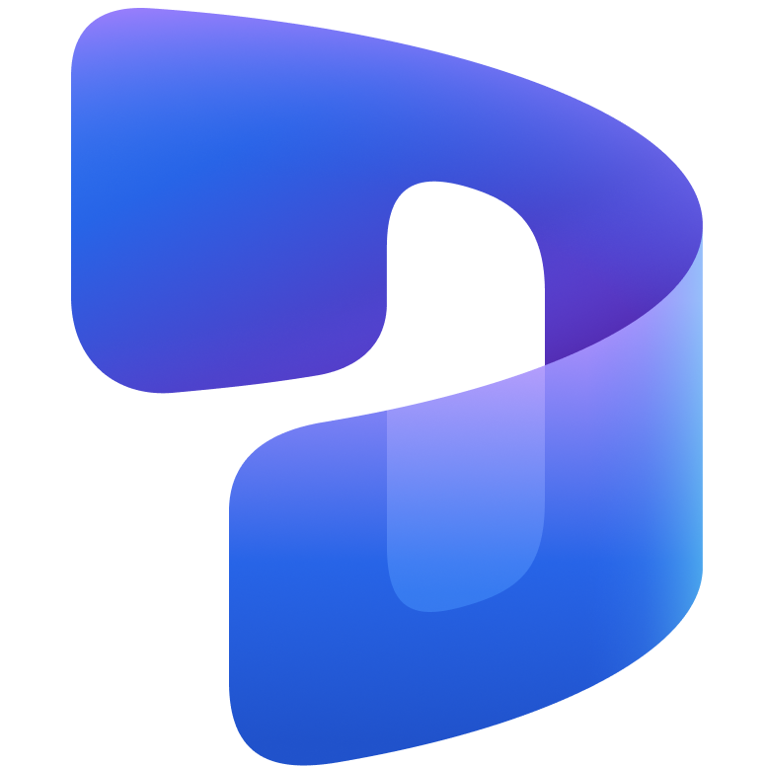

The tools
take the backseat.
Your business takes the front seat.

Slide 6
Power Series Labs
Automate Work in Power Apps with Supervised Agents

Slide 7


The Power Series
One Catalog. Five Tracks. Endless Possibilities.
Let your business need shape the solution.
The Power Series gets you hands-on with every Power Platform capability, so you design the right solution for any business process – one or more apps, automations and agents, working together on a governed foundation. Run a track end to end, or pick the modules that fit your scenario, audience and skill level.
Digitize Internal Operations
Replace manual work with focused apps and connected data
Automate workflows and processes
Reduce repetitive work with automation, approvals, and AI
Improve customer interactions
Create secure experiences for customers, partners and communities
Modernize existing applications
Evolve legacy solutions with modern apps, automation, and AI
Strengthen governance and security
Apply guardrails, visibility, and control across the platform

Slide 8
The Power Series
Lab: Automate Work in Power Apps with Supervised Agents
Configure Copilot Studio agents that use Power Apps MCP server tools.
Add email and Dataverse triggers that automate agent execution.
Publish agents into Agent Feed for review inside a model-driven app.

Slide 9
MCP architecture: Client-server model
MCP Host
The AI application (VS Code, GitHub Copilot)
Dedicated connection
MCP Server
MCP Client
MCP Client
Exposes tools, resources, and prompts
Maintains connection
Maintains connection
One client per server
MCP Server
Exposes tools, resources, and prompts
MCP Host: The AI application (VS Code, GitHub Copilot)
MCP Client: Maintains connection to an MCP server
MCP Server: Exposes tools, resources, and prompts that AI can use
Host creates one MCP Client per MCP Server
Each client maintains a dedicated connection
Servers expose Tools, Resources, and Prompts
Notes:
MCP (Model Context Protocol) is an open-source standard for connecting AI applications to external systems. Using MCP, AI applications like Claude or ChatGPT can connect to data sources (e.g. local files, databases), tools (e.g. search engines, calculators) and workflows (e.g. specialized prompts)—enabling them to access key information and perform tasks. Think of MCP like a USB-C port for AI applications. Just as USB-C provides a standardized way to connect electronic devices, MCP provides a standardized way to connect AI applications to external systems.
MCP follows a client-server architecture where an MCP host — an AI application like Claude Code or Claude Desktop — establishes connections to one or more MCP servers. The MCP host accomplishes this by creating one MCP client for each MCP server. Each MCP client maintains a dedicated connection with its corresponding MCP server. Local MCP servers that use the STDIO transport typically serve a single MCP client, whereas remote MCP servers that use the Streamable HTTP transport will typically serve many MCP clients. The key participants in the MCP architecture are: MCP Host: The AI application that coordinates and manages one or multiple MCP clients
MCP Client: A component that maintains a connection to an MCP server and obtains context from an MCP server for the MCP host to use
MCP Server: A program that provides context to MCP clients

Slide 10
Where each server fits in the Power Platform stack
Agent runtime
Copilot Studio · VS Code · Claude · Azure AI Foundry
Supervised
orchestration layer
Power Apps MCP Server
invoke_data_entry · request_assistance · log_for_review
Model-driven app (UX + business rules)
Forms · views · plugins · agent feed · workflows
Generic data
access layer
Dataverse MCP Server
list_tables · describe_table · read_query · CRUD · Search/Fetch
Dataverse platform
Key insight
Tables · relationships · security roles · audit · CDS engine
They sit at different altitudes — they are complements, not substitutes.
Notes:
The Power Apps MCP Server enables agents to automate repetitive app tasks, with human review and approval through the new task-centric enhanced agent feed. The Power Apps MCP Server also provides built‑in supervision tools that allow humans to review, assist, and take control of agent actions when needed.

Slide 11
Choose Power Apps MCP when…
Unstructured-to-structured intake with review
Example: Customer emails parcel claims; agent extracts claim type, parcel ID, amount → review record in clerk's feed.
Why this server: invoke_data_entry is purpose-built for this; clerk sees side-by-side email + draft record.
Agent must hand off to a named user
Example: Permit application missing a required attachment → request_assistance fires a task to the case owner.
Why this server: Agent Feed delivers a deep-linked, actionable task — no manual email routing.
Compliance requires human approval before writes
Example: Updates to regulated finance, HR or legal records in a model-driven app.
Why this server: Built-in approval canvas keeps the audit trail inside Dataverse, not in side channels.
Existing model-driven app needs an agent layer
Example: Extending an existing Dynamics 365 Customer Service deployment with autonomous triage.
Why this server: Agent Feed becomes the natural surface for agent-human handoff inside the app the team already uses.

Slide 12
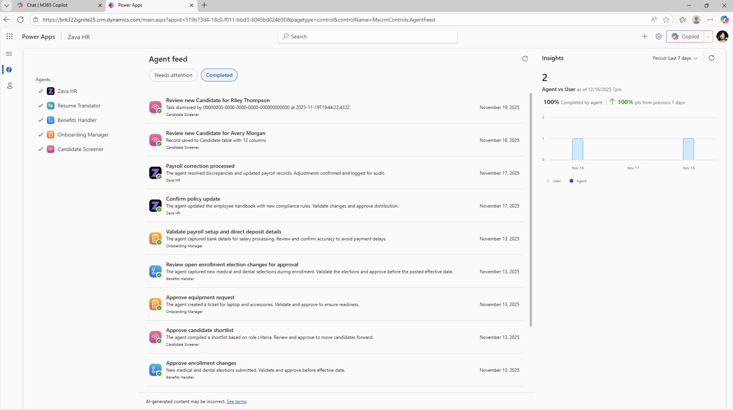
Agent Feed
Agents + humans getting work done in a single hub
Centralized command center: Agent feed gives you a unified view to monitor, manage, and collaborate with agents across workflows—no toggling between tools.
Real-time collaboration: Agents and users stay in sync through timely notifications, status updates, and contextual prompts.
Actionable intelligence: The feed surfaces insights, suggestions, and automation triggers, empowering users to act quickly—prioritizing and unblocking agentic flows.

Slide 13
Automate manual processes with human review when it matters.
The Power Apps MCP Server gives AI agents a secure way to work with your business apps and route exceptions to people for review.
Business scenario: Invoice processing with exception review
The finance team receives invoices by email and spends time entering details, checking records, and routing exceptions.
An invoice email automatically starts the process.
The agent captures the details and updates the finance record.
If the amount, vendor, or purchase order does not match, the issue appears in Agent Feed.
A finance employee reviews and approves the exception inside the business app.
Impact: less manual tracking and data entry, faster processing, reduced errors, and human review only where it adds value.

Slide 14
Get Started – https://aka.ms/PowerSeries/AgentFeed
Timer
40 mins

